Slide 1
SOLR Measurement
6 Thrus

Slide 2
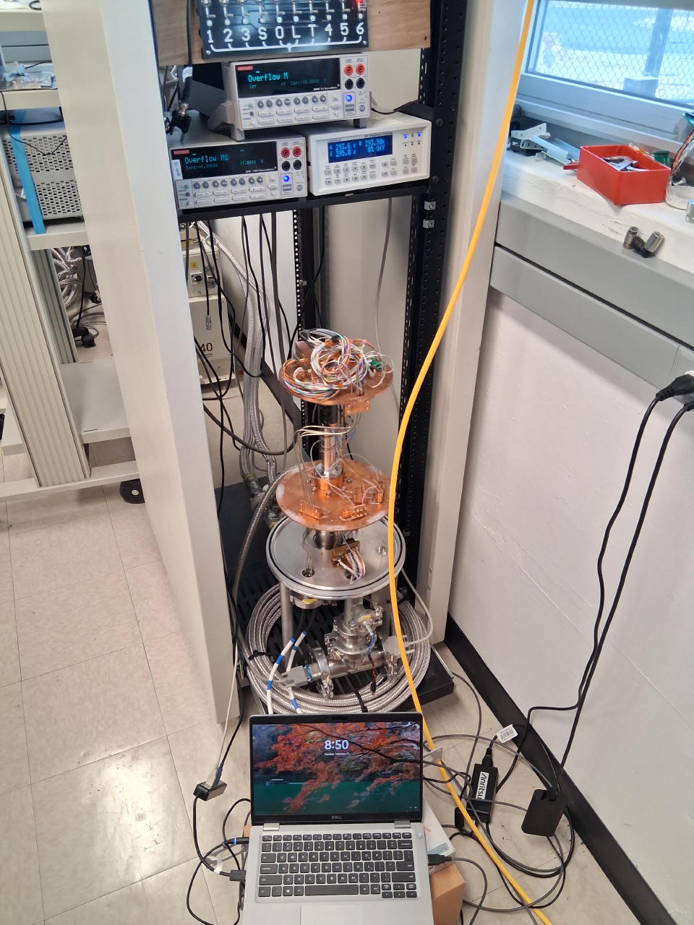
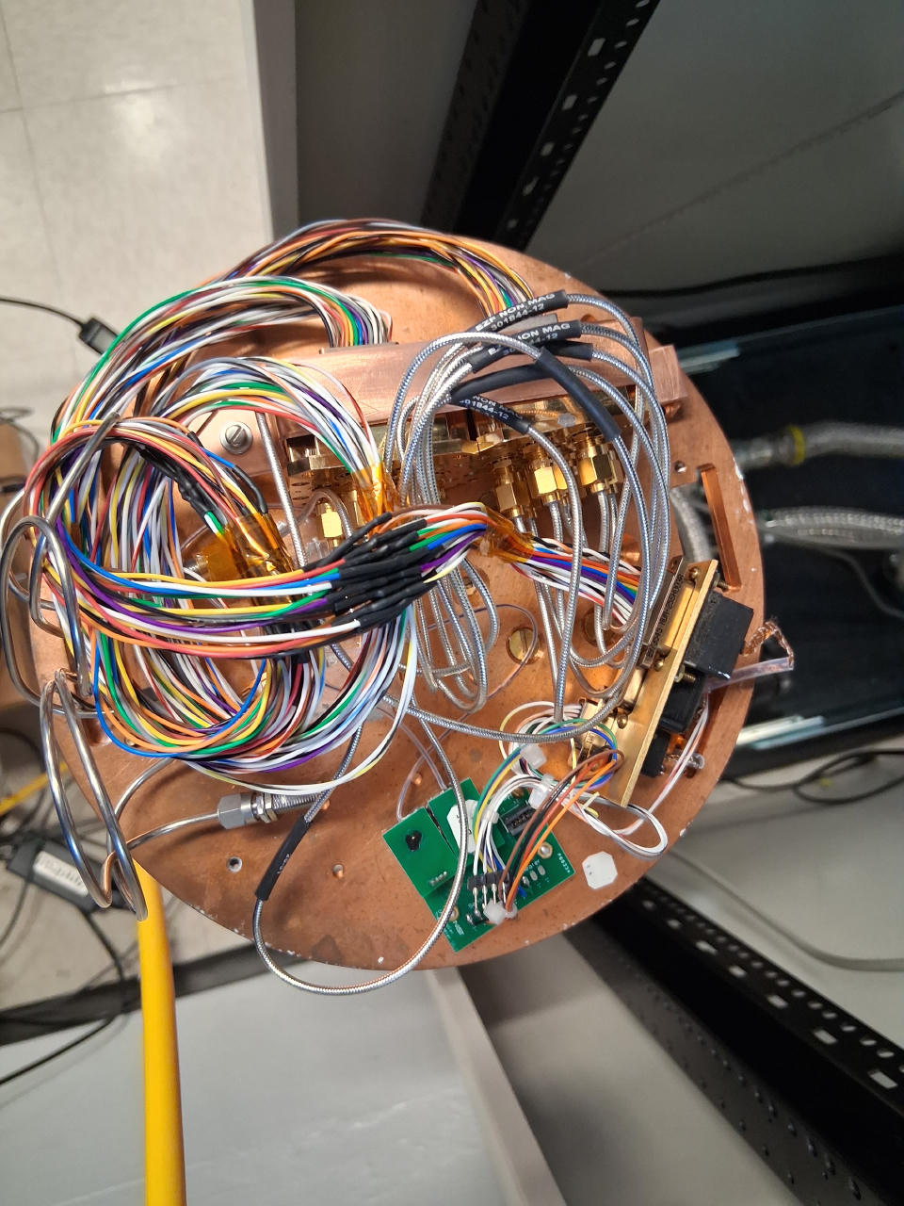

Slide 3
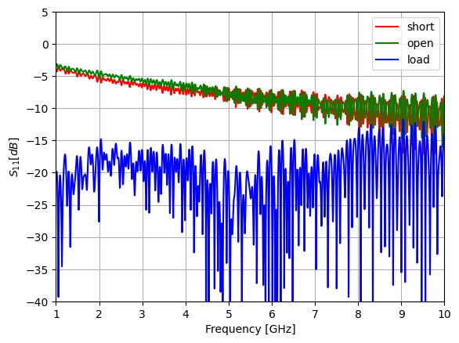
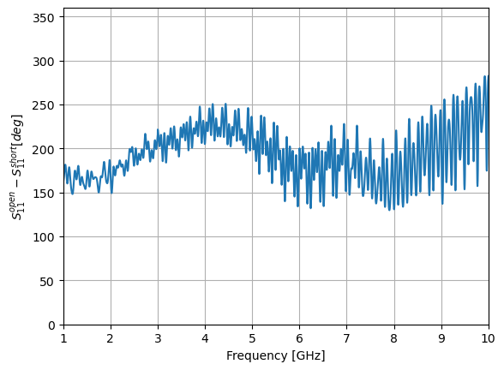
Warm SOL Reflections

Slide 4
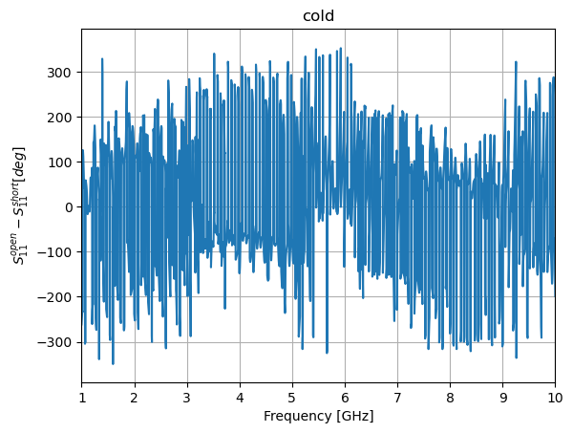
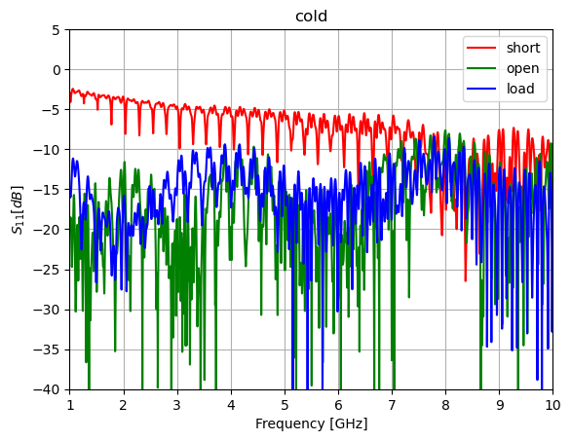
Cold SOL Reflections

Slide 5
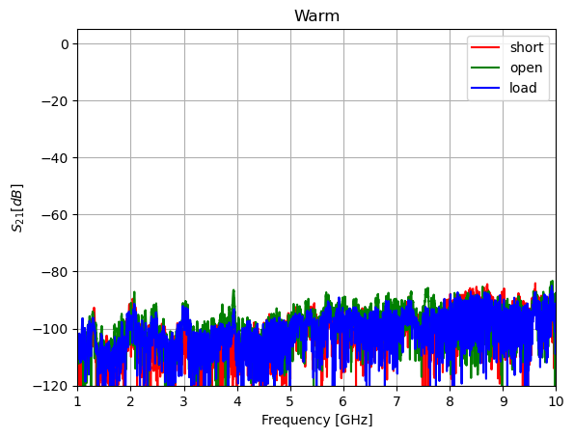
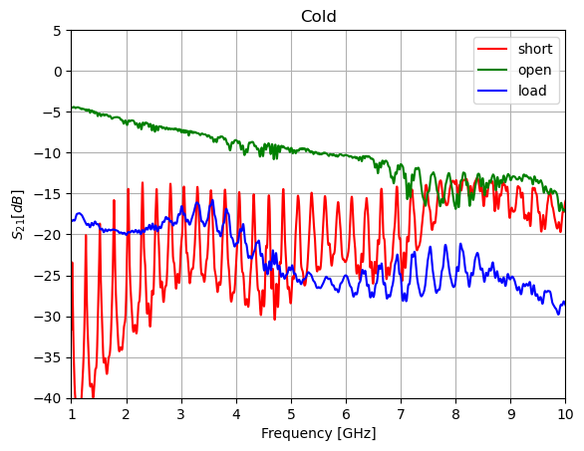
S21 and S12 of SOL(uh oh!)

Slide 6
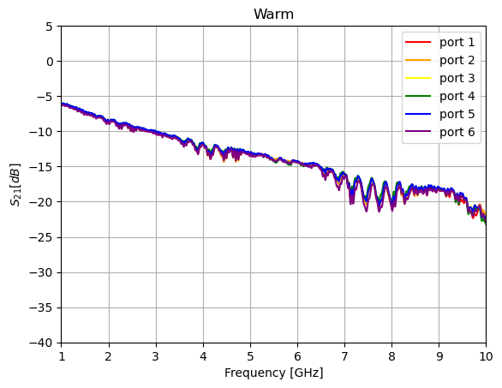
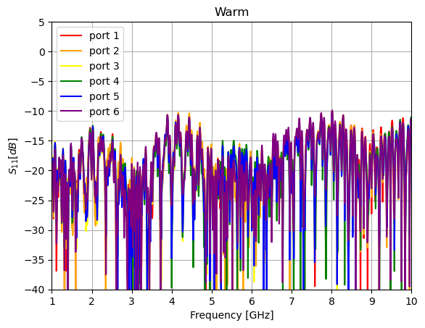
THRUs

Slide 7
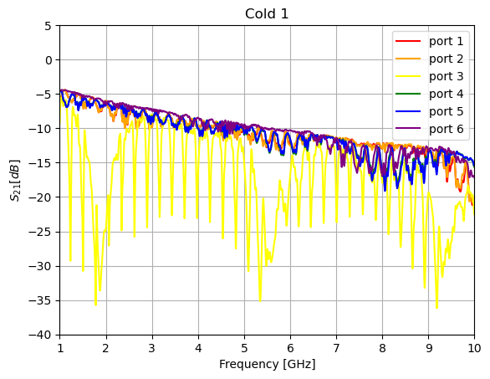
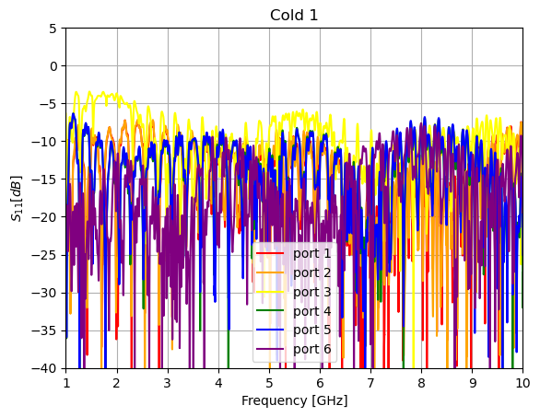
Cold Thrus(switch stuck)

Slide 8
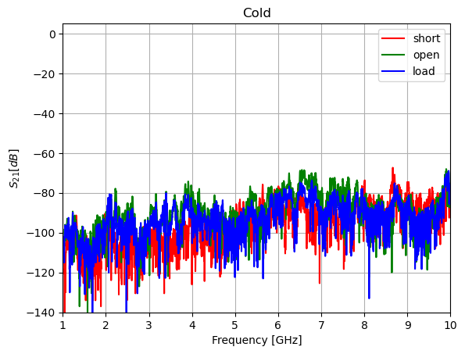
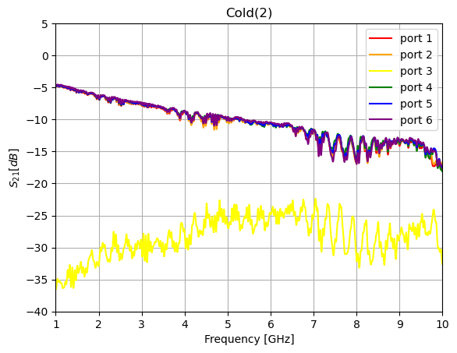
Warmed up to 45 K and suddenly it fixed itself!
Cooled back down and it remained fixed, while in open state
After re-cool from 45 K to 7 K
This is repeatable

Slide 9
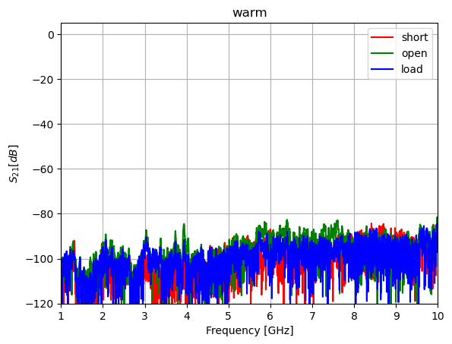
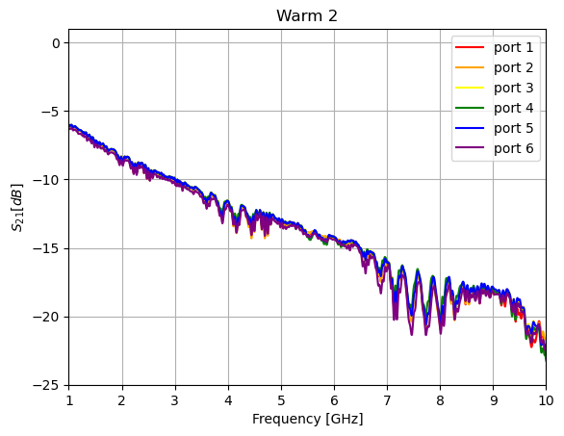
Warm 2, after warm up from last cooldown

Slide 10
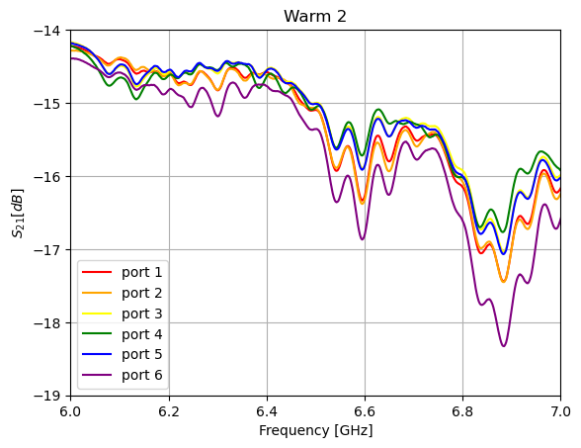
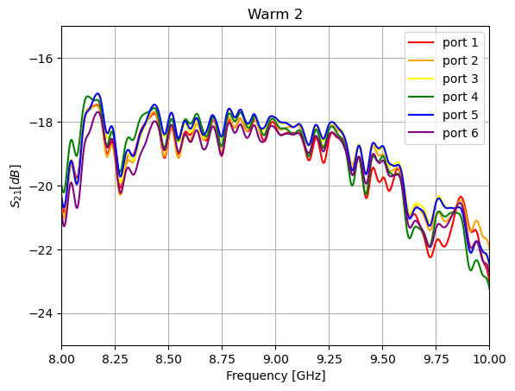
Zoom in on thru data

Slide 11
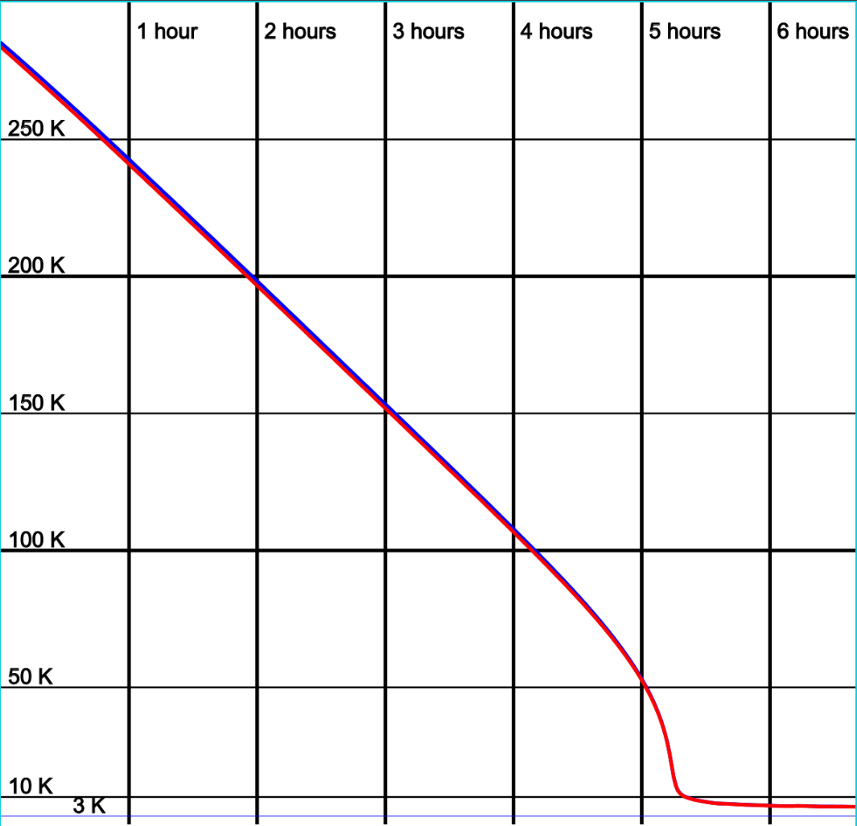
Feb 19-Feb 20 2026

Slide 12
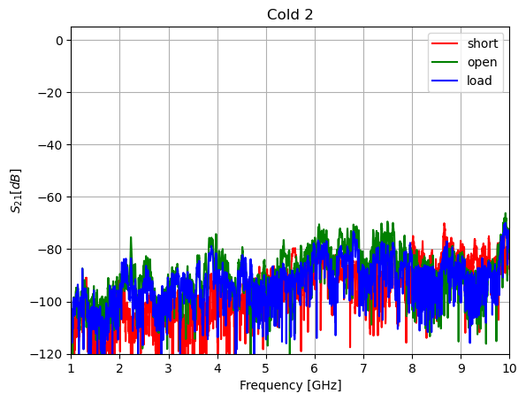
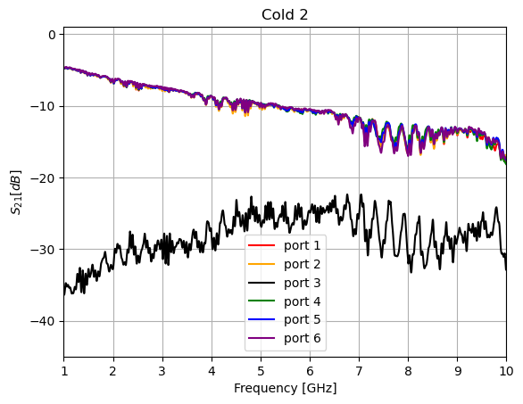
Second cooldown after full cycle: port 3 still bad!

Slide 13
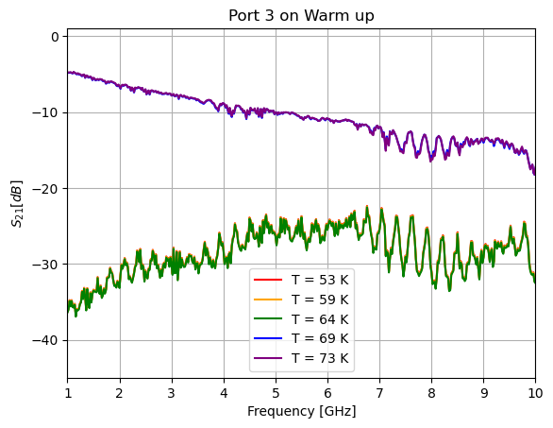

Slide 14
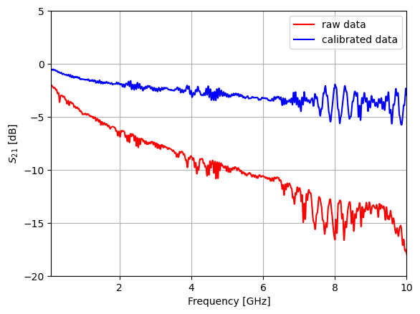
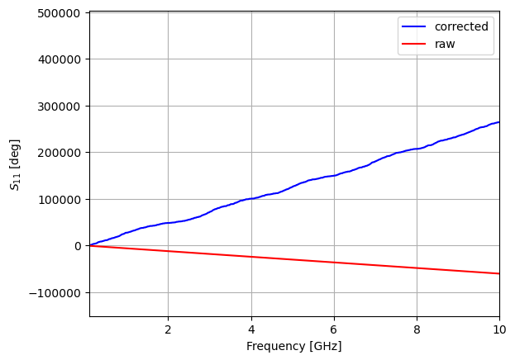
Cal attempt with ideal thru as identity matrix

Slide 15
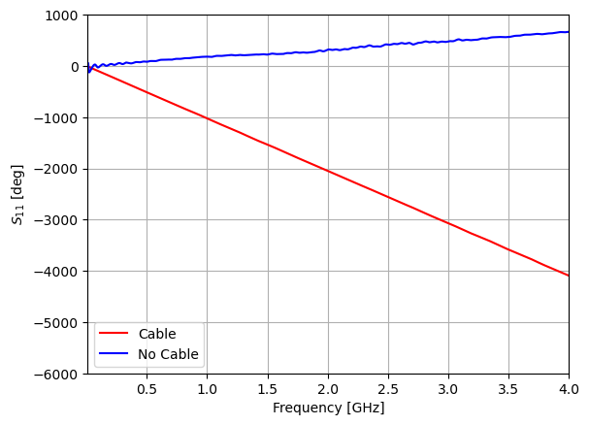
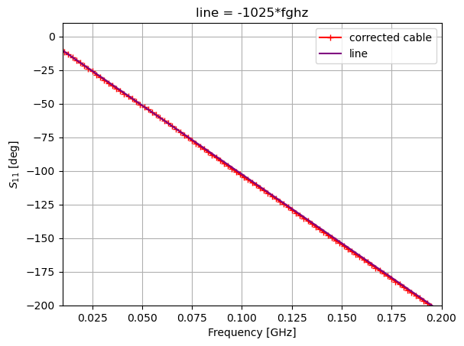
One end of cable disconnected on port 1, 1 port E-cal

Slide 16
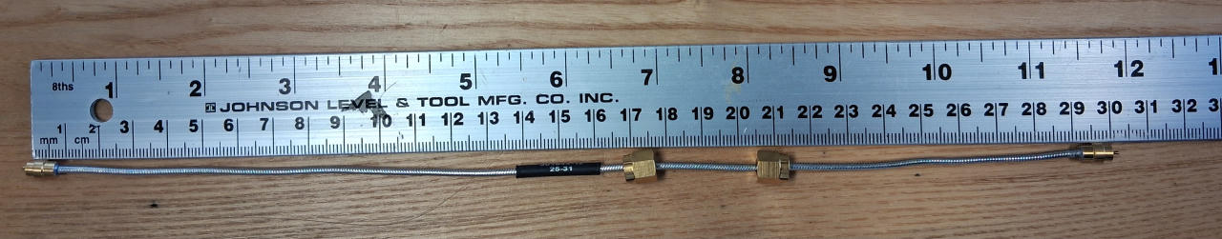
Non-magnetic cable used for “thru”

Slide 17
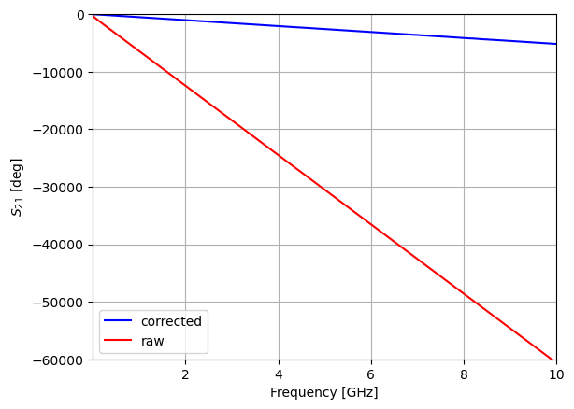
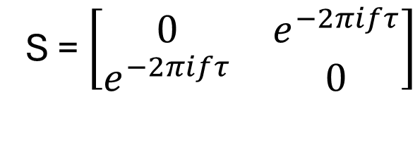
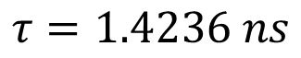
Fixed! Thru ideal should NOT be identity, but rather [[0,1],[1,0]]! Also, added phase delay
S = $\left[\begin{matrix}0 & e^{−2πifτ} \\ e^{−2πifτ} & 0\end{matrix}\right]$
$$τ=1.4236 ns$$

Slide 18
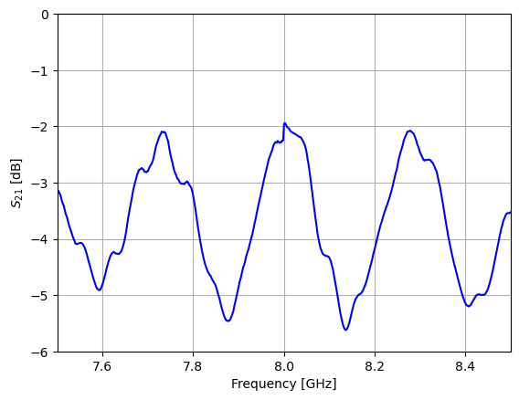
Zooming in on corrected data to try to understand reflections

